Slide 1




An App for finding events and locating places to eat nearby the event

Slide 2
Concept
MVP
Provide an easy way for people to search by city, category, and date range to find events
Provide event details and pin location to a Google map
Provide user the ability to easily find places to eat that are near to their selected event
Option for user to provide email if they want to subscribe to mailing list

Slide 3
Improvements
Ability to display directions to the event
Each well that displays an event to expand vertically in response to the vertical stretch of the content

Slide 4
Team Members
Rebecca Ionescu – UI/UX
Brent Hillen – UI/UX
Jessi Spildener – API/Javascript
Jessica Fain – Firebase
Sarah Janesz – API/Javascript

Slide 5
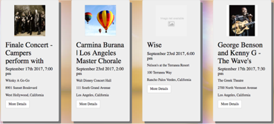
Design
Bootstraps Framework
Responsive Design
Carousel
Form for user input
Search bar: input-group-addon, dropdown, placeholder
jQuery: Narrow wells: 3 column divs and 11 subcolumn divs
CSS styling eg. box-shadow, opacity, z-index, tooltip

Slide 6
API
Eventful
Utilized API to access events in both random and user chosen cities
title, date, address, event image
second page including more event details
Google Maps & Places
Utilized Eventful API to access latitude & longitude of events and using Google Maps API to create map and mark event on map
Utilized Google Places web services to find nearby places to eat and mark them on the map

Slide 7
Firebase
Utilized Firebase to store user email addresses for future marketing purposes
Addresses were also stored in the console
Email address input is validated via HTML as well as in the JS code

Slide 8
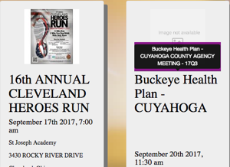
Other Items
jquery ui: tooltip
.html file: link and script tags
.js file: $(‘.title’).tooltip();
.css file: background color, etc.

Slide 9
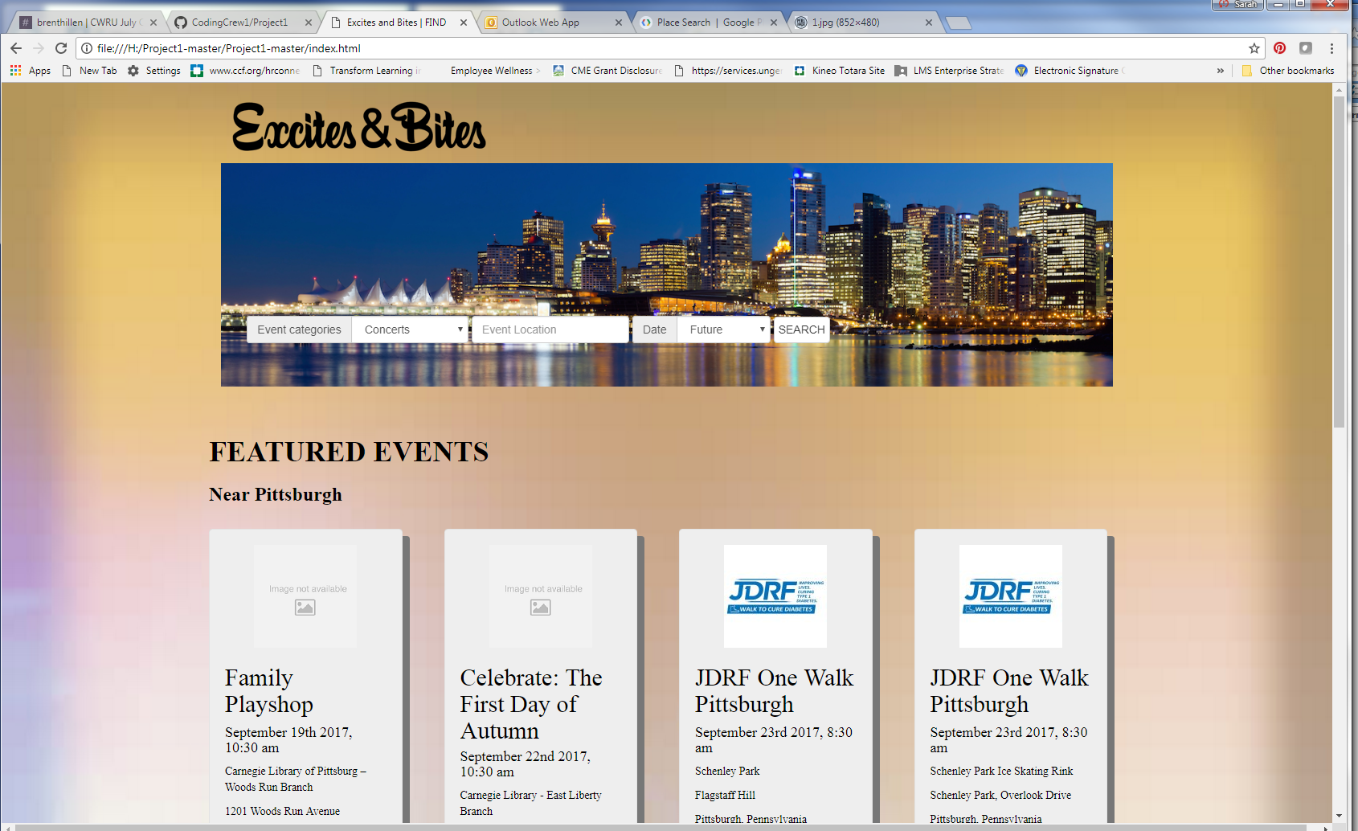
Demo Time…

